Slide 1

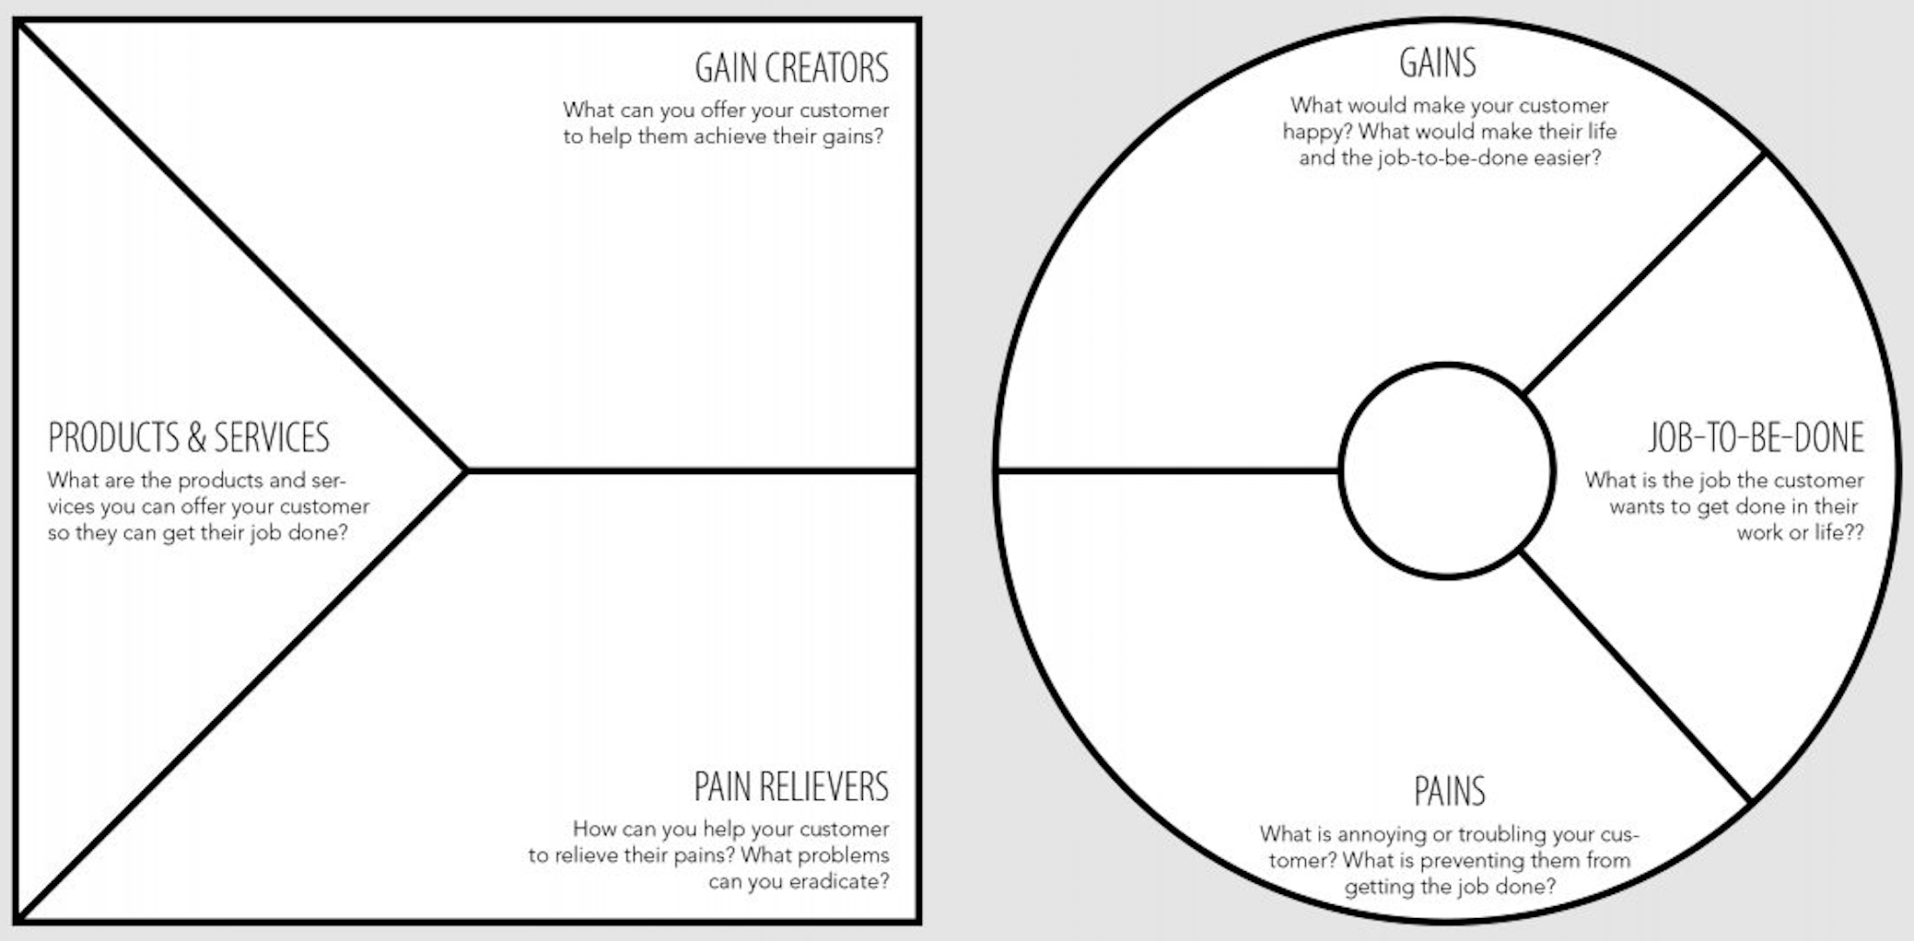
Value Proposition Canvas for Student Side
Close collaboration with universities and possible employers
Machine learning algorithm for matching
Matching previews and recommendations
Automated CV-Update
Platform matching students to employers to get relevant job experience
Automated data-collection
1-Click application
Automated analysis of their skillset
Finding and applying to the right jobs
Holistic solution
Transparent application process
Connection to other platforms, such as LinkedIn, to create CVs/applications in seconds
Recommend suitable job offers
Broad offers
on job market
Different formats of application
Significantly reduce time of application
Uncertainty about success rate
Inconvenient and time intense task of application
The student doesn’t have to narrow down his/her 3-5 years of studying to 2-5 key words
Collecting relevant experience and references

Slide 2

Value Proposition Canvas for Company Side
Summary of relevant skills from applicates
Fast and convenient recommendation of ideal candidates
Automated data-collection
Multi feature search with job description
Holistic solution
Automated database and talent pool
Platform matching students to employers to get relevant job experience
1-Click hiring
Large amount of possible and flexible candidates
Finding and recruiting the right talents
Ability to compare potential applicants easily
Automated skill and knowledge extraction from written text
The newest skills on the market can easily be hired
Broad offer of new skills
Vast numbers of young and motivated students
Selection of the right skills
Offering open positions for talents
A substitute of a job is found faster then ever
Expensive Hire-And-Fire situations
Time intense definition of job-descriptions
No random application with little to no matching rate
Many offers from multiply suppliers

Slide 3

Value Proposition Canvas for University Side
Data about the relevance of their modules
Clear focus on what to improve
Realtime feedback on the performance of their students
Data feedback of the students after graduation
Real time market feedback about the added value of the courses
Justification for their action
Know the requirements from the job market and student side
No need for expensive and tedious post graduation surveys
Predictions about possible market trends
Opacity of the career path and performance after graduation.
Ensure competitive programs for the job market
Quantitative data on how important / relevant a course of study is
laborious market research regarding the programs

Slide 4
Problem
Solution
Unique Value Proposition
Unfair Advantage
Customer Segments
Finding the right matches between applicants and entry-level jobs
Text mining, collaborative / content based filtering, automation
Key Metrics
Channels
Existing Alternatives
High-Level Concept
Early Adopters
Cost Structure
Revenue Streams

Slide 5
Problem
Solution
Unique Value Proposition
Unfair Advantage
Customer Segments
Students often cannot gain relevant work experience in their field of study
Platform connecting students looking for work experience and organizations in need of exactly these skills as support
Online job market platform specifically tailored to student needs
Students
integration of University
Organisations
Students search for a matching job for too long
ML algorithm for optimized matching
FHNW
Key Metrics
Channels
Online application
Existing Alternatives
High-Level Concept
Early Adopters
Jobs.ch, monster, coople, traditional headhunting
Career fairs
Cost Structure
Revenue Streams
Marketing costs
Brokerage fee
Development costs
Pay per Lead
HR

Slide 6
Value Propositions
Key Partners
Key Activities
Talent on demand
Job matching
Customer Relationships
Customer Segments
Establish connection to Prof / Demand
External perspective for their work
Automated communication
FH / Uni
Students
Career promising jobs
Refactoring of job descriptions
Recommendations
Establish relationship to companies
SBFI
SEM
Group assignments
Interesting real world cases for students
Venture capital
Key Resources
Channels
Start up
Realtime feedback
References and network
Attractive modules
Career fairs
Platform
Online marketing
Enterprises
Group assignments
Matching algorithm
Sprout-Scout Project
Companies
Career promising jobs
Flexible contracts
Mobile app
Pupils
Different data sources
Automated contract
Platform
Development cost
Cost Structure
HR
Revenue Streams
Sprout-Scout Project
Job matching
Operational cost
MVP
Body leasing
Pay-per-lead
Consulting
Infrastructure
Group assignment
Funding
Network effect
Marketing
Advertising

Slide 7
Key Partners
Key Activities
Value Propositions
Customer Relationships
Customer Segments
Interesting real world cases for students
Automated communication
FH / Uni
References and network
Students
Staatssekretariat für Bildung, Forschung und Innovation SBFI
External perspective for their work
SEM
Key Resources
Attractive modules
Channels
Start up
Refactoring of job descriptions
Career fairs
Enterprises
Realtime feedback
Online marketing
Talent on demand
Pupils
Social marketing
Premium Job
Cost Structure
Students Projects
Revenue Streams
Full Service

Slide 8
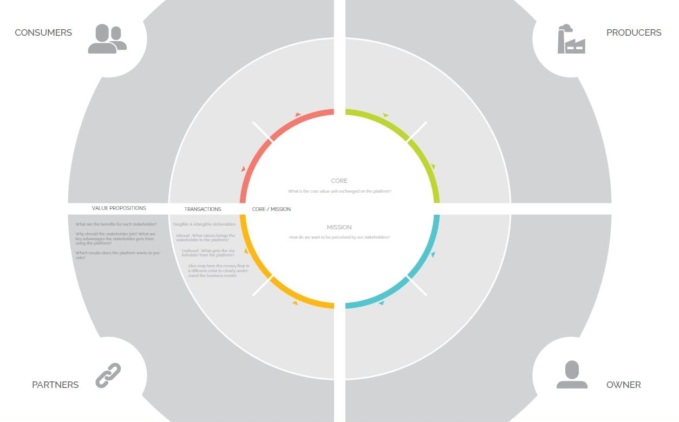
Find the matching job faster
Industry
Offers a job / Platform
Students from the FHNW
Gains money and experience
Offers a job / Platform
The industry has a demand on skilled workers and create job opportunities
Find better fitting employees
Offers his knowledge
Gets the right person for the right position
Text mining, collaborative / content based filtering, automation
Receives feed-back
Provides the technology
LinkedIn
Get e real-time feedback on the relevance of the courses
Earn money for each hire
Provides data and connections
Customer data and money
FHNW
Course description
Students data
Notes:
Platform Innovation Canvas

